Slide 1
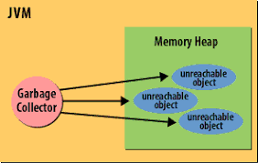
Java Garbage Collector
In Java destruction of object from memory is done automatically by the JVM. When there is no reference to an object, then that object is assumed to be no longer needed and the memory occupied by the object are released. This technique is called Garbage Collection.
Advantages of Garbage Collection
The programmer doesn't need to worry about dereferencing an object.
Increases memory efficiency because garbage collector removes the unreferenced objects from heap memory decreases the chances of the memory leak.
It is done automatically by JVM so we don't need to make extra efforts.

Slide 2
How can an object be unreferenced?
There are many ways:
By nulling the reference
By assigning a reference to another
By anonymous object etc.
Employee e=new Employee();
e=null;
Employee p1=new Employee();
Employee p2=new Employee();
p1=p2;//now the first object referred by p1 is available for garbage collection
new Employee();

